Slide 1
English Writing II
Week 15 Results and Discussion

Slide 2
In today’s class
The writing of “Results” and “Discussion”
The submission of in-class writing tasks
The requirements of the final project

Slide 3
Review: Writing about the Method
Purpose
Subjects/ participants
Materials/ instruments
Procedures
Measurement of the variables
Statistical treatments

Slide 4
Writing about the Method
Simple past tense
Passivization
Objective and academic style

Slide 5
Writing about the “Results”
12-minute scanning of “Results” and “Discussion”
The Results section of a scientific research paper represents the core findings of a study.
It presents these findings in a logical sequence without bias or interpretation, setting up the reader for later interpretation and evaluation in “Discussion”.

Slide 6
“Analytic ability”

Slide 7
“Pausing in Writing”

Slide 8
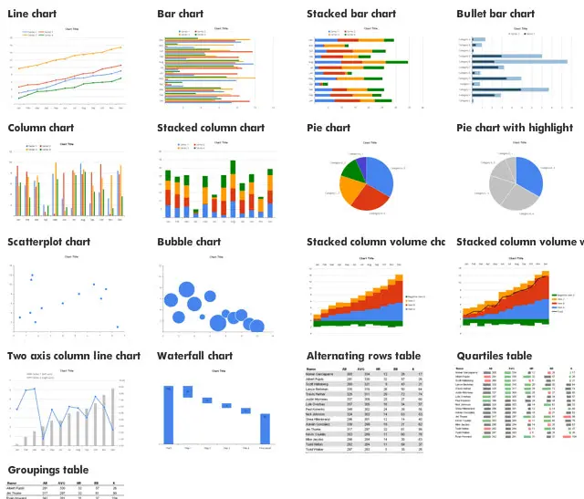

Slide 9
Use tables and figures
Summarize the results in the text, drawing on the figures and tables to illustrate your points.
The text and figures should be complementary, not repeating the same information.
You should refer to every table or figure in the text. Any that you don’t feel the need to refer to can safely be moved to an appendix, or even removed.

Slide 10
Writing about the “Discussion”
Interpret and explain your results (so what)
Answer your research question
Justify your approach
Critically evaluate your study

Slide 11
Writing of the “Discussion”
The Discussion section needs to follow from the results and relate back to your literature review. Make sure that everything you discuss is covered in the results section.
You also need to demonstrate that you understand the limitations and the implications of your study. This section should be written in the present tense.

Slide 14
Variation: Writing a “Conclusion”
Summary of the major findings
Implication of the study
Limitations
Suggestions for future research

Slide 15
“Articulatory skills”

Slide 16
“Oral fluency”

Slide 17
Submission of the in-class writing tasks
By midnight today
404: “contagious” vs. “infectious”
802: PEE paragraph
1001: Counterargument
1401: Key information in “Method” section

Slide 18
Requirements for the final project
A research paper (IMRD) of an empirical study related to the pandemic
Word count: 1200-1500
Abstract (key words), appendix, references (at least 3)
APA format

